Slide 1




Advanced Web
Nikolay Kostov
Senior Software Developer and Trainer
http://nikolay.it
Telerik Software Academy

Slide 2

Table of Contents
Web Performance
Minimize HTTP Requests
Server Performance Tips
CSS Tips
JavaScript Tips
Content Tips
Images Tips
Cookies Tips
Accessibility
Search Engine Optimization (SEO) Tips

Slide 3
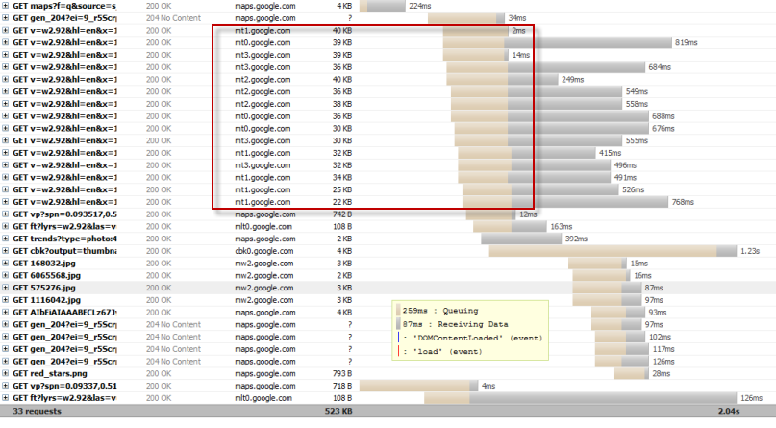
Minimize HTTP Requests

Slide 4
Minimize HTTP Requests
80% of the end-user response time is spent on the front-end
Most of this time is tied up in downloading all the components in the page
images, stylesheets, scripts, Flash, etc.
40-60% of daily visitors to your site come in with an empty cache
This is the most important guideline for improving performance for first time visitors

Slide 5
Combined files
Combining all scripts into a single script
For scripts that are used in all pages
Combining all CSS into a single stylesheet
For styles that are used in all pages
Combining files is more challenging when the scripts and stylesheets vary from page to page
ASP.NET MVC has bundling features which combines scripts and styles into one file

Slide 6
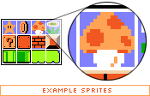
CSS Sprites
Method for reducing the number of image requests
Combine background images into a single image
Use the CSS background-image for the image
Use background-position, width and height to cut the image you need
http://alistapart.com/articles/sprites

Slide 7
Image maps
Combine multiple images into a single image
Only work if the images are contiguous in the page, such as a navigation bar
Not recommended but still an option
CSS Sprites do better job
http://www.w3.org/TR/html401/struct/objects.html#h-13.6

Slide 8
Inline images
Use the data: URL scheme to embed the image data in the actual page (using base64)
http://tools.ietf.org/html/rfc2397
This can increase the size of the HTML document
Combining inline images into your (cached) style sheets is a way to reduce HTTP requests and avoid increasing the size of your pages
Inline images are not yet supported across all major browsers

Slide 9

Server Performance Tips

Slide 10
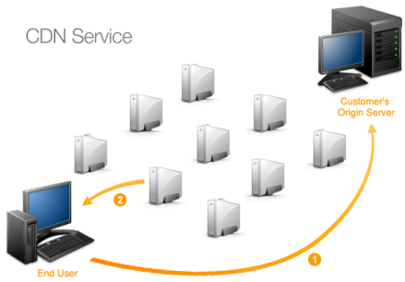
Use a Content Delivery Network
Deploying your content across multiple, geographically dispersed servers will make your pages load faster from the user's perspective
CDN service providers:
Akamai Technologies
EdgeCast
etc.

Slide 11
Expires and Cache-Control
For static components
Implement "Never expire" policy by setting far future Expires header
Expires: Thu, 30 Jan 2020 20:00:00 GMT
For dynamic components
Use an appropriate Cache-Control header to help the browser with conditional requests
http://www.w3.org/Protocols/rfc2616/rfc2616-sec14.html#sec14.9

Slide 12
Gzip Components
Compress the content and reduces web traffic
Web clients indicate support for compression with the Accept-Encoding header
Accept-Encoding: gzip, deflate
Web server may compress the response using one of the methods listed by the client
Content-Encoding: gzip
Gzip is the most popular and effective compression method at this time
The price for compression is CPU time

Slide 13
Configure ETags
Entity tags (ETags) are a mechanism that web servers and browsers use to determine whether the component in the browser's cache matches the one on the origin server
Server:
ETag: "10c24bc-4ab-457e1c1f"
Client
If-None-Match: "10c24bc-4ab-457e1c1f"
More flexible than the last-modified date
http://en.wikipedia.org/wiki/HTTP_ETag

Slide 14
Flush the Buffer Early
When users request a page, it can take some time for the backend server to generate HTML
During this time, the browser is idle as it waits for the data to arrive
A good place to consider flushing is right after the HEAD
Examples:
PHP: …</head><?php flush(); ?><body>…
ASP.NET: <% Response.Flush(); %>
ASP.NET MVC: Impossible: Inside-out rendering

Slide 15
Use GET for AJAX Requests
When using XMLHttpRequest (AJAX request), POST is implemented in the browsers as a two-step process:
Sending the headers first, then sending data
GET only takes one TCP packet to send (unless you have a lot of cookies)
The maximum URL length in IE is 2K, so if you send more than 2K data you might not be able to use GET
Semantically: GET = get data, POST = save data

Slide 16
Avoid Empty Image src
They may appear in two forms:
<img src="">
var img = new Image(); img.src = "";
Both forms cause the same effect: browser makes another request to your server.
IE makes a request to the directory of the page
Safari and Chrome – request to the same page
Firefox 3.5+ and Opera does not do anything when an empty image src is encountered.

Slide 17

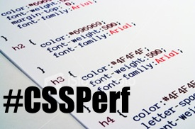
CSS Tips

Slide 18
Put Stylesheets at the Top
Moving stylesheets to the document HEAD makes pages appear to be loading faster
Putting stylesheets in the HEAD allows the page to render progressively
The browser display whatever content it has as soon as possible
Some browsers block rendering to avoid having to redraw elements of the page if their styles change
The user is stuck viewing a blank white page.

Slide 19
Avoid CSS Expressions
CSS expressions are a powerful and dangerous way to set CSS properties dynamically
evaluating the JavaScript expression
Example: background-color: expression( (new Date()).getHours()%2?"#B8D4FF" : "#F08A00" );
Only supported in IE5, IE6 and IE7
These expressions are evaluated when the page is rendered, resized or scrolled and even when the user moves the mouse over the page

Slide 20
Make JS and CSS External
JavaScript and CSS files are cached by the browser
We should find balance between number of requests and the size of our HTML
JavaScript and CSS that are inlined in HTML documents get downloaded every time the HTML document is requested
In some cases some pages may find that inlining JavaScript and CSS results in faster end-user response times (reducing the number of JS and CSS files requests)

Slide 21
Minify JavaScript and CSS
Minification is the practice of removing unnecessary chars from code to reduce its size
Obfuscation is an alternative optimization
more likely to generate bugs
Tools for minifying JS and CSS
http://jscompress.com/
http://code.google.com/p/minify/
http://developer.yahoo.com/yui/compressor/
ASP.NET MVC has powerful minification

Slide 22
Other CSS Tips
In IE @import behaves the same as using <link> at the bottom of the page, so it's best not to use it.
CSS should be at the top in order to allow for progressive rendering
Avoid Filters
The IE-proprietary AlphaImageLoader filter aims to fix a problem with some PNGs
It blocks rendering also increases memory use
Use gracefully degrading PNG8 instead

Slide 23
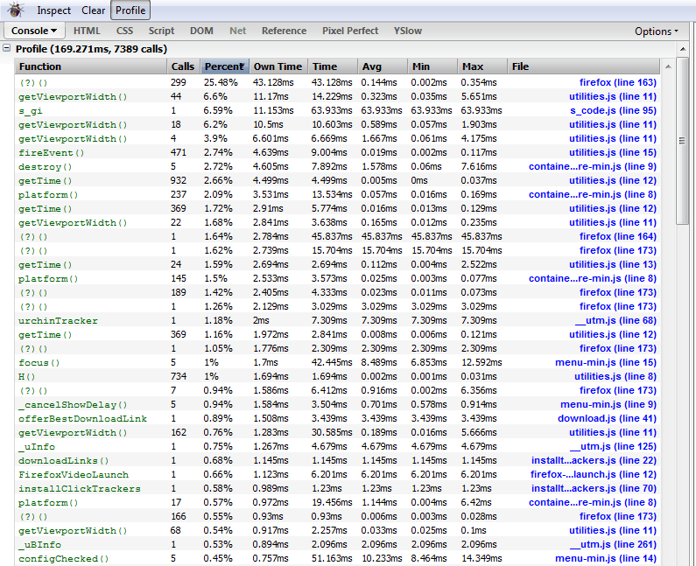
JavaScript Tips

Slide 24
Put Scripts at the Bottom
The problem caused by scripts is that they block parallel downloads
Usually browsers download no more than two components in parallel per hostname
Downloading JS files blocks all downloads
The DEFER attribute indicates that the script does not contain document.write()
<script src="script.js" defer></script>

Slide 25
Remove Duplicate Scripts
It hurts performance to include the same JavaScript file twice in one page
Unnecessary HTTP requests
Wasted JavaScript execution
Some browsers (like Firefox) avoid this
Two of the top 10 U.S. web sites contain a duplicated script
Another tip: include versions in script names to prevent the use of old cached files when you ship new version of your site

Slide 26
Minimize DOM Access
Accessing DOM elements with JavaScript is slow so in order to have a more responsive page, you should:
Cache references to accessed elements
Update nodes "offline" and then add them to the DOM tree
Avoid fixing layout with JavaScript
http://yuiblog.com/blog/2007/12/20/video-lecomte/

Slide 27
Develop Smart Event Handlers
Sometimes pages feel less responsive because of too many event handlers attached to different elements
That's why using event delegation is a good approach:
If you have 10 buttons inside a div, attach only one event handler to the div wrapper, instead of one handler for each button
Events bubble up so you'll be able to catch the event and get the button it originated from

Slide 28

Content tips

Slide 29
Reduce DNS Lookups
The Domain Name System (DNS) maps hostnames to IP addresses
Typically takes 20-120 milliseconds for DNS to lookup the IP address for a given hostname
The browser can't download anything from this hostname until the DNS lookup is completed
DNS lookups are cached for better performance
Reducing the number of unique hostnames reduces the number of DNS lookups

Slide 30
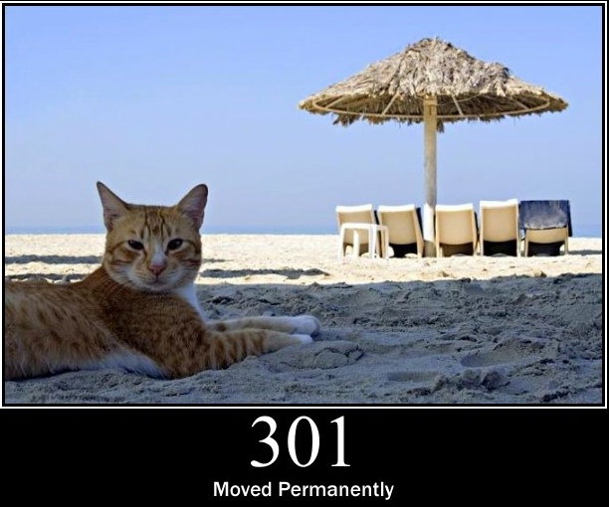
Avoid Redirects
Redirects are accomplished using the 301 and 302 status codes
HTTP/1.1 301 Moved Permanently Location: http://example.com/newuri/
When a trailing slash (/) is missing from a URL some web servers (applications) redirect
Prefer HTTP redirects instead of meta refresh tag or JavaScript to ensure the back button works correctly

Slide 31

Make Ajax Cacheable
Even though your Ajax responses are created dynamically, and might only be applicable to a single user, they can still be cached
Some of the other rules also apply to Ajax:
Gzip Components
Reduce DNS Lookups
Minify JavaScript
Avoid Redirects
Configure ETags

Slide 32
Pre-load/Post-load Components
What's absolutely required in order to render the page initially?
The rest of the content and components can wait
By preloading components you can take advantage of the time the browser is idle and request components for the next pages
Tools:
YUI Image Loader
YUI Get utility
Lazy loading of JavaScript: RequireJS

Slide 33
Reduce the Number of DOM Elements
It makes a difference if you loop through 500 or 5000 DOM elements
How many DOM elements do I have?
document.getElementsByTagName('*').length
Are you throwing in more <div>s only to fix layout issues?
Maybe there's a better and more semantically correct way to do your markup

Slide 34
Split Components Across Domains
Splitting components allows you to maximize parallel downloads
Make sure you're using not more than 2-4 domains because of the DNS lookup penalty
Example:
dynamic content on www.example.org
split static components between static1.example.org and static2.example.org
Link: Maximizing Parallel Downloads

Slide 35

Minimize the Number of iframes
iframes allow an HTML document to be inserted in the parent document
<iframe> pros:
Helps with slow third-party content like ads
Download scripts in parallel
Security sandbox
<iframe> cons:
Costly even if blank
Blocks page onload
Non-semantic

Slide 36

No 404s (Not Found)
HTTP requests are expensive
Making an HTTP request and getting a useless response (i.e. 404 Not Found) is unnecessary
Particularly bad is when the link to an external JavaScript is wrong and the result is a 404
The browser may try to parse the 404 response body as if it were JavaScript code
Check all your links and only show valid links!

Slide 37
Mobile tips
Keep Components under 25K
iPhone won't cache components bigger than 25K (uncompressed size, gzip can help here)
http://yuiblog.com/blog/2008/02/06/iphone-cacheability/
Pack Components into a Multipart Document
Packing components into a multipart document is like an email with attachments
fetch several components with one HTTP request (iPhone doesn’t support it)
http://en.wikipedia.org/wiki/MHTML

Slide 38

Images Tips

Slide 39
Optimize Images
Use imagemagick to check if image is using less color than the palette in it (optimize it)
Try converting GIFs to PNGs
anything a GIF can do, a palette PNG (PNG8) can do too (except animations)
Run pngcrush (or any other PNG optimizer tool) on all your PNGs
Run jpegtran on all your JPEGs
lossless JPEG operations (rotation, optimization, removing of useless information)

Slide 40
Optimize CSS Sprites
Arranging the images in the sprite horizontally as opposed to vertically usually results in a smaller file size
Combining similar colors in a sprite helps you keep the color count low, ideally under 256 colors so to fit in a PNG8
Don't leave big gaps between the images in a sprite
Requires less memory for the user agent to decompress the image into a pixel map

Slide 41
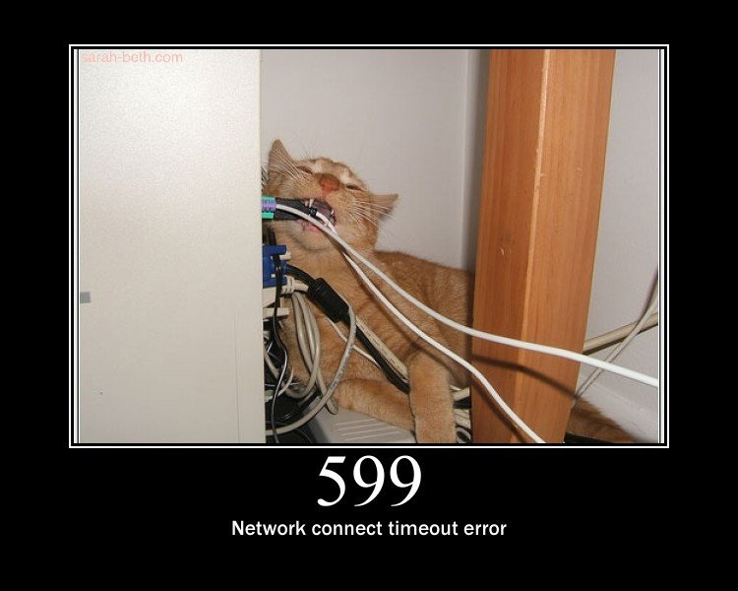
Don't Scale Images in HTML
Don't use a bigger image than you need just because you can set the width and height
If you need <img width="100" height="100" src="mycat.jpg" alt="My Cat" /> then your image (mycat.jpg) should be 100x100px rather than a scaled down 500x500px image

Slide 42

Make favicon.ico Small and Cacheable
The favicon.ico is an image that stays in the root of your server
If you don't have it the browser will still request it
It's better not to respond with a 404 Not Found
Imagemagick can help you create small favicons
Make it cacheable by using Expires and Last-Modified

Slide 43

Cookies Tips

Slide 44

Reduce Cookie Size
HTTP cookies are used for a variety of reasons such as authentication and personalization
Information about cookies is exchanged in the HTTP headers between web servers and browsers in EVERY request
It's important to keep the size of cookies as low as possible to minimize the impact on the user's response time

Slide 45
Reduce Cookie Size (2)
Tips:
Eliminate unnecessary cookies
Keep cookie sizes as low as possible
Be mindful of setting cookies at the appropriate domain level so other sub-domains are not affected
Set an Expires date appropriately
An earlier Expires date or none removes the cookie sooner, improving the user response time

Slide 46
Cookie-free Domains for Content
When the browser makes a request for a static image and sends cookies together with the request, the server doesn't have any use for those cookies
They only create traffic for no good reason
If your domain is www.site.org you can host your static components on static.site.org
Don’t set cookies for *.site.org or use different domain for static content
YouTube uses ytimg.com

Slide 47
Performance - Useful links
Yslow – analyzes web pages and suggests ways to improve their performance
http://developer.yahoo.com/yslow/
Yahoo Best Practices – The main source for this presentation:
developer.yahoo.com/performance/rules.html
Response Times: The 3 Important Limits
http://www.nngroup.com/articles/response-times-3-important-limits/

Slide 48

Accessibility
“A person’s a person, no matter how small”
Dr. Seuss

Slide 49
Accessibility
Craft content minding disabled users
Blind - include text equivalents of images, use labels in forms
Colorblind - do not convey information using color only
Visually impaired - avoid small font sizes
Epileptic - avoid flashing content (3Hz or more)
Physical disabilities - avoid functionality that relies only on the mouse or keyboard

Slide 50
Accessibility (2)
Why implement accessibility?
Some accessibility features are mandatory for government sites in some countries (US, NL, SW)
“Everyone gets visited by a very important blind user, named Google”
Some SEO and accessibility considerations overlap

Slide 51
Accessibility (3)
Standards
Web Content Accessibility Guidelines (WCAG) - http://www.w3.org/WAI/intro/wcag
Section 508 - http://www.section508.gov
Tools
Will never replace manual testing, but may help
WAVE - http://wave.webaim.org/

Slide 52


Search Engine Optimization
Getting ahead in search engines

Slide 53
Search Engine Optimization
Search engines use so-called “crawlers” to get the content of the page and index it
The crawlers weigh the data on the page
<title>, page URL and headings have great weight
Links from highly valued pages to your page increase its value (Google Page Rank)
Add alt text to images
Use relevant keywords in the content and <meta> tags

Slide 54
Search Engine Optimization (2)
Search engines love good content
Learn to write for the web
Inverted pyramid (bottom line goes first)
Meaningful link text (no “click here”)
No SEO technique will replace good content
"Content is king"
"Build sites for people, not search engines"
https://www.google.com/support/webmasters/

Slide 55
Summary
In order to make your page loads faster:
Minimize HTTP Requests and Use CDN
Cache and compress your content
Minify, combine and optimize CSS, JS, Images
Move CSS files at the top and JS at the bottom
Minimize DOM elements and DOM access
Split your content into cookie-less domains
Use all other small advices and tips to improve the performance of your web application

Slide 56
Web Performance
http://schoolacademy.telerik.com

Slide 57
Homework
Optimize given HTML and CSS code (see Advanced Web Homework.zip).
Apply a CSS style to given HTML page (see Advanced Web Homework.zip).
Combine given CSS files (see Advanced Web Homework.zip).
Create a sprite with set of icons (see Advanced Web Homework.zip).
* Write and publish few SEO articles (see Advanced Web Homework.zip).

Slide 58



Free Trainings @ Telerik Academy
“C# Programming @ Telerik Academy
csharpfundamentals.telerik.com
Telerik Software Academy
academy.telerik.com
Telerik Academy @ Facebook
facebook.com/TelerikAcademy
Telerik Software Academy Forums
forums.academy.telerik.com

